Slide 1


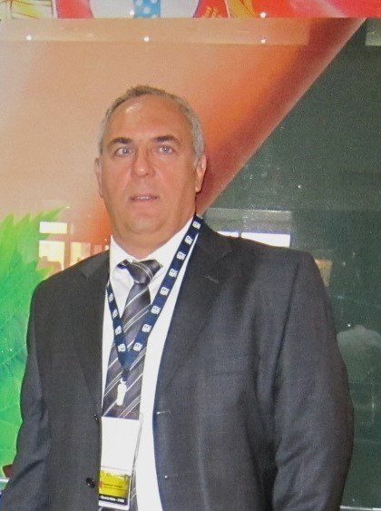
Flue Gas Decarbonization-
Descarbonização de gases de combustão
CCT – CARBON CAPTURE TRANSFORMATION
DOMENICO CAPULLI
Capulli, Domenico–Chemical Engineer and Environmental Consultant domenicocapulli@gmail.com

Slide 2


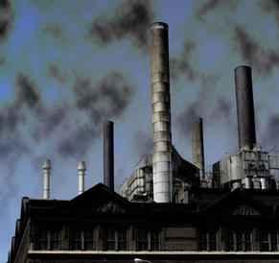
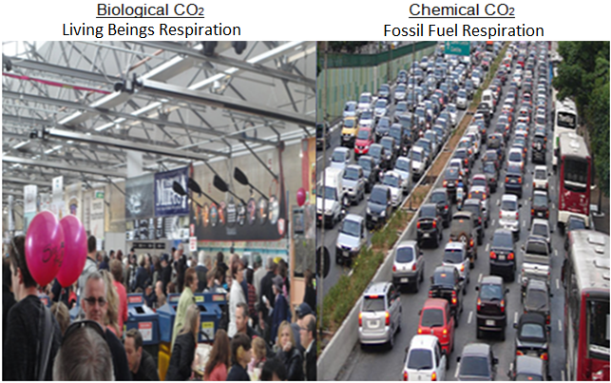
The Problem: Carbon imbalance
The Intergovernmental Panel on Climate Change (IPCC) declared in 2018 that the world needs to reach net zero emissions by 2050 if it is to meet the Paris Agreement goal of limiting global warming to 1.5°C. The 2050 deadline was later included in the Glasgow Climate Pact agreed at COP26 in 2021 (Serin E., 2023).
The generation of energy by combustion, that is, the oxidation of fossil fuels in mechanical arrangements such as engines, turbines, boilers, and furnaces, generates gaseous emissions containing high fractions of carbonic acid that impact the planet's troposphere, preventing the return of solar rays and contributing to the so-called greenhouse effect.
Components such as dust, soot, smoke, combustion gases, water vapor, salt spray, and microorganisms make the air a contaminated and unsuitable raw material; The removal of elements oblivious to the natural composition of the air requires dynamic technologies capable of processing large volumes and removing substances in different physical states such as solids and gases.

Slide 3

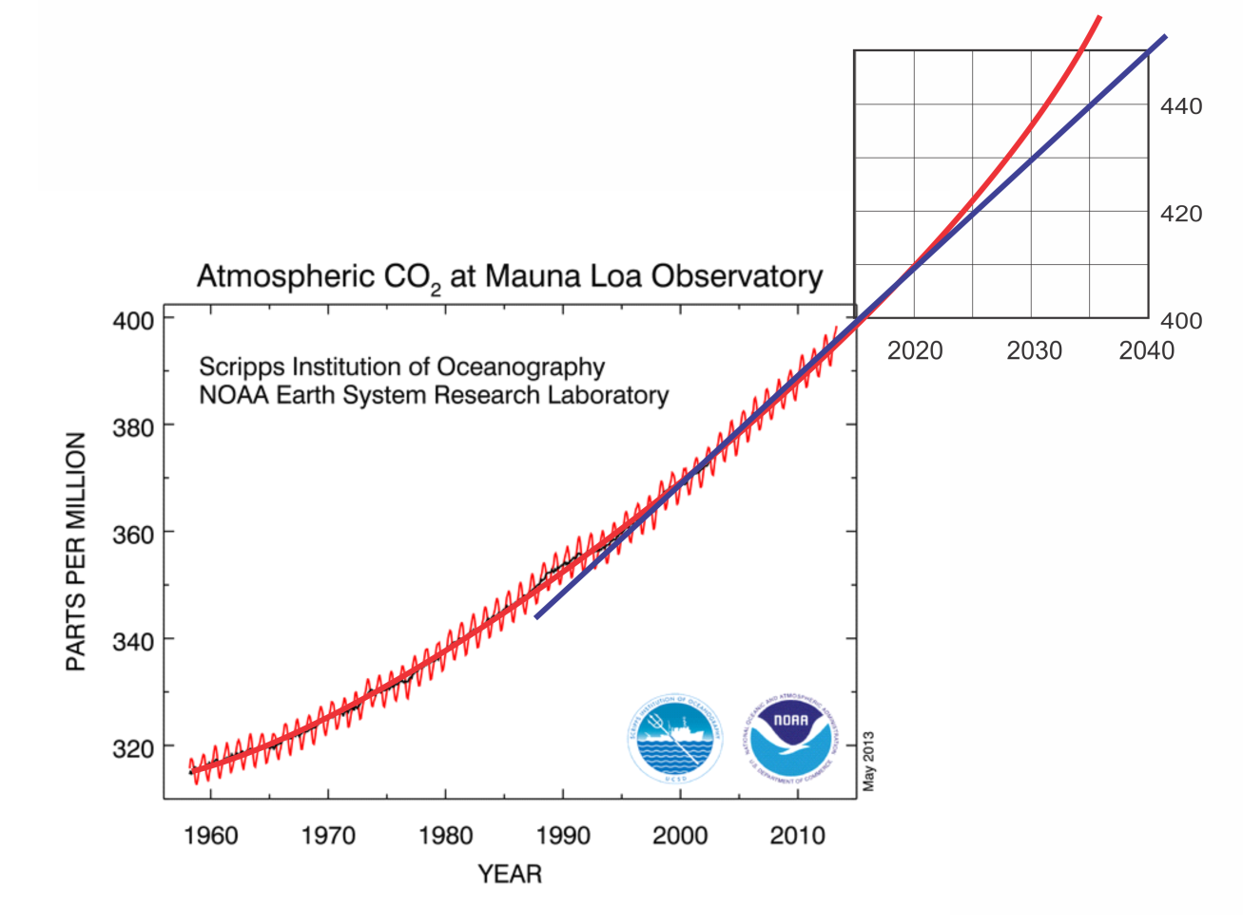
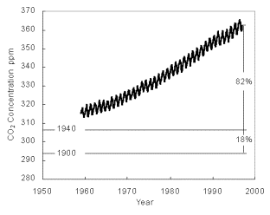
CARBON DIOXIDE CO2+H2O = CARBONIC ACID
The decarbonization of our planet's atmosphere is humanity's challenge, as the repercussions are global, as demonstrated on climate websites where the air quality is bad or harmful, even in remote locations.
As measured in isolated locations such as Manua Loa in Hawaii, which show the change in tangent, alerted in 2000, configured as shown in Graph 1, where we have the evolution in the form of a mountain range of CO2 rates in the global atmosphere with values such as 421 ppm of CO2 in April 2023.
Evolution of carbonic acid concentration in the atmosphere.
(Source: https://gml.noaa.gov/ccgg/trends/mlo.html, 2023.)

Slide 4
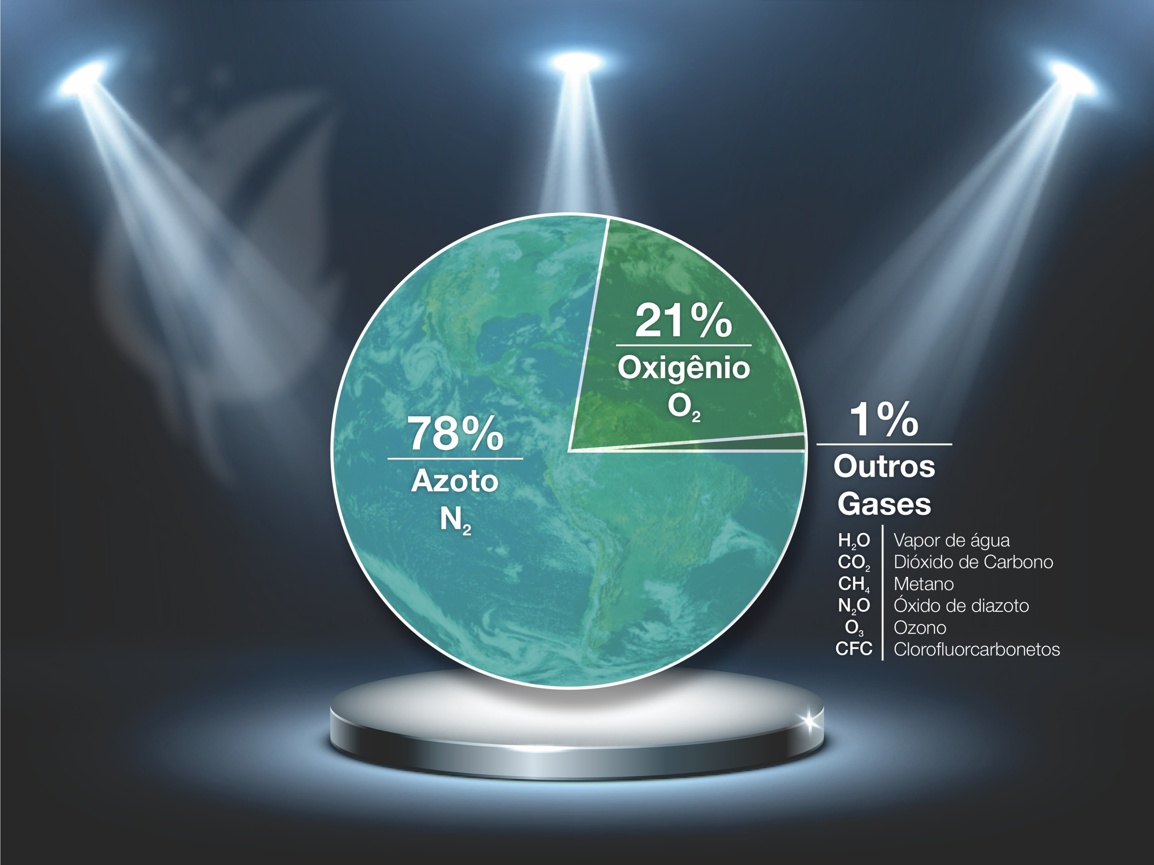
BRAINSTORMING FOR SOLUTIONS !
Our approach aims to establish a counterpoint in the currents of global mitigation actions, with this study being restricted to those that act on combustion gases, the initiatives of CCS (Carbon Capture & Storage), CCUS (Carbon Capture, Utilization & Storage), gain a new proposition under our argument is CCT (Carbon Capture & Transform).
According to the Massachusetts Institute of Technology (MIT) Environmental Solutions Initiative, some of the captured carbon dioxide is pumped into oil wells as a way to “dispose of hard-to-extract oil.” Additionally, it is used in some greenhouses to help grow plants. Other potential uses include “turning CO2 into plastics, building materials like cement and concrete, fuels, futuristic materials like carbon fibers and graphene, and even household products like baking soda, bleach, antifreeze, and paints.” None of them are in large-scale production yet.
IN NATURE NOTHING IS CREATED,
NOTHING IS LOST,
EVERYTHING IS TRANSFORMED.
ANTOINE-LAURENT DE LAVOISIER(1785)

Slide 5
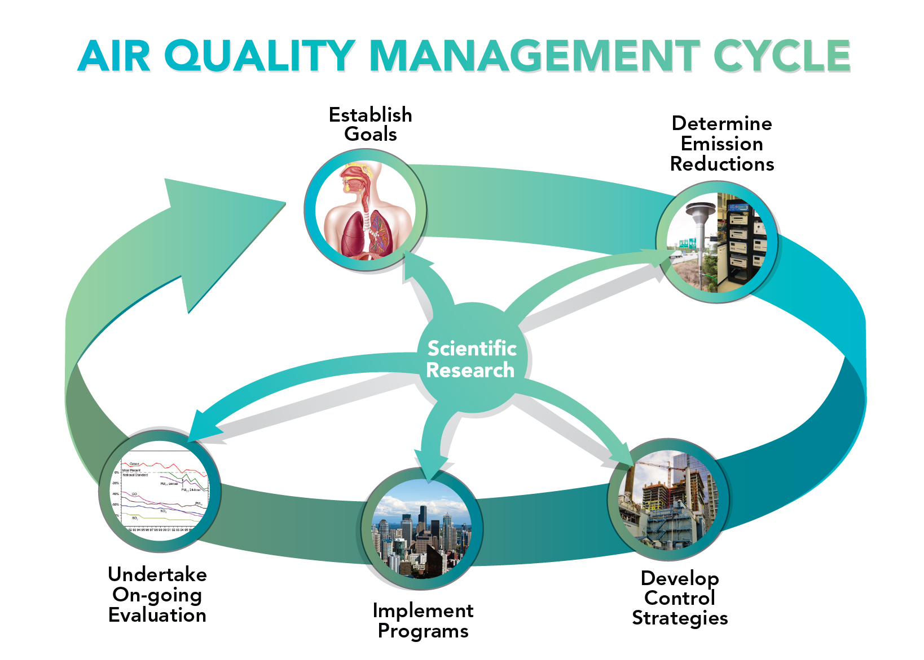
Stoichiometric Burning.
CxHy + 𝑥+𝑦4 O2 → xCO2 + 𝑦2H2O + Particulate matter(“fly ash”) + Energy
Energy generation we have the oxidation of fossil fuels, the so-called combustion process, with oxygen promoting the breakdown of organic molecules, and generating a rate of 3.66 t CO2/t Carbon
Chemical Route
acid + base >>> salt + water
Through gas scrubbers that represent a more rational solution for transforming carbon dioxide into a solid “in situ” for everyday use, and with added economic value, such as calcium carbonates and sodium bicarbonate where the mass balance shows the mass incorporation in the products resulting from the reactions, in which one of the reactants is in the air as a contaminant. Here we will restrict ourselves to the analysis of the wet route of gas scrubbers, more specifically that of hydrodynamic precipitators, based on multiventuri liquid centrifugation technology, achieving efficient carbon dioxide conversion, with compact dimensions, constant performance, and "in situ" applicability
Carbon dioxide emissions are being compared using technologies to separate the other components contained in the combustion gas streams, given the large proportion of nitrogen oxides and excess oxygen, in addition to solid contaminants such as particulate matter. Among these, we have absorption and desorption by amines, adsorption on active carbon, and the typical acid–base reactions.

Slide 6
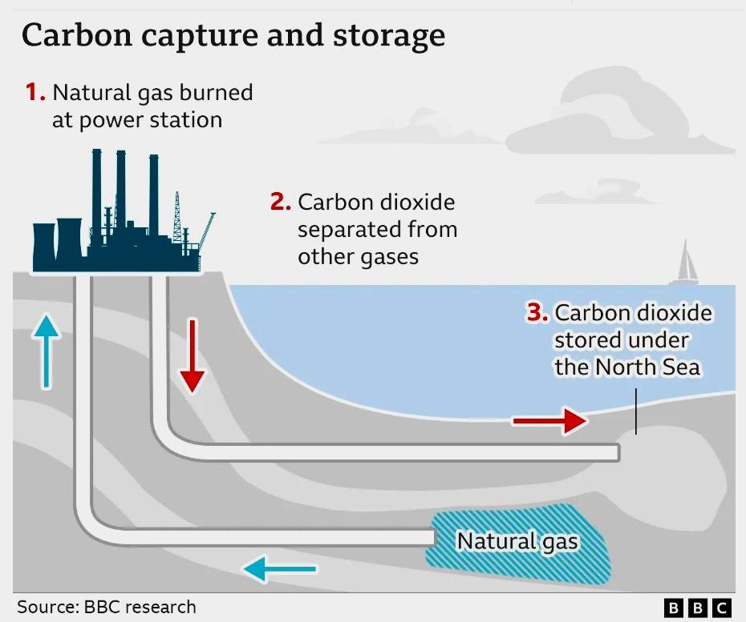
GLOBAL AGREEMENT DUBAI 2023.
Criticism regarding the inefficiency, cost, or inadequacy of the solutions presented and promoted, including in international challenges, such as XPRIZE Carbon Removal, and COP28 in Dubai in December 2023, where an agreement was drawn up that marks the “beginning of the end” of the era of fossil fuels, setting the stage for a rapid, fair and equitable transition, underpinned by deep emissions cuts and increased financing.
Gas emissions need to be reduced by 43% by 2030, compared to 2019 levels, to limit global warming to 1.5°C, Global Goal on Adaptation (GGA) - Targets that the world needs to reach to be resilient to the impacts of a changing climate.
Technological Route:
CCS- Carbon Capture Storage
In an overview of the list of CCS technological routes for CO2 sequestration, the techniques range from capturing carbonic acid before being released into the atmosphere in power plants and storing it underground, to the use of trees for fixing or equipment capable of removing it directly from the ambient air.
CCS concept of carbon dioxide capture and storage in underground caverns: High cost to separate and transport to the location of underground caverns.

Slide 7
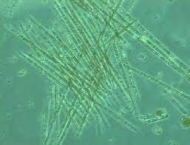
Technological Route CCT-CARBON CAPTURE TRANSFORM
The R&D status of carbon capture technologies is challenging and complex and includes:
Cryogenic separation,
Membrane separator,
Adsorption, Air and Flue gas washing with amines, is currently the reference technique for CO2 sequestration, however, the energy consumption is around 0.2 – 0.5 MWh/t CO2 segregated, which represents 20-30% of the production capacity thermoelectric generation.
Absorption, by liquid chemical reaction has a stoichiometric gain of 37% and 55% by mass of the products resulting from spontaneous chemical reactions, with calcium hydroxide and a chemical neutralization reaction caused by sodium hydroxide in both reactions, the CO2 turns into a soluble solid.
CO2 + 2CaOH > Ca2CO3 + H2O.
44 + 118 > 140 + 18
CO2 + 2NaOH > Na2CO3 + H2O.
44 + 80 > 106 + 18
(Xiaoxing Wang, 2020).
Biological capture, exerted by microalgae, is more efficient, and algae do not have lignin, being a carbon fixed photosynthetically and easily converted in the food chain or for oil extraction for energy generation.
Cyanophyceous algae

Slide 8
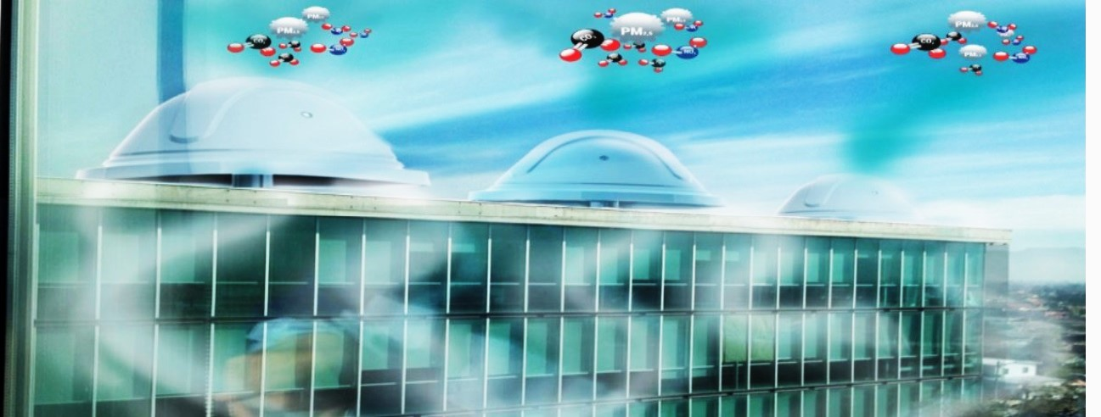
Technological Route to FLUE GAS DECARBONIZATION- CCT-CARBON CAPTURE TRANSFORM
Negative Emission Technologies (NETs) are methods designed to remove carbon dioxide (CO₂) from the atmosphere and store or transform it safely.
This synthetic exposition shows the incipience of the technologies in use, a fact that makes the use of BADCT technologies (“Best Available Demonstrated Control Technology”) mandatory, that is, the best control technologies proven to exist. The multiventuri liquid centrifugation technology was developed and patented in Brazil. Its underlying concept is based on the convergence of molecular vibration amplitude, in which we cool the gaseous stream and increase kinetic energy in the refrigerated alkaline liquid to excite the liquid and reduce the enthalpy of the gas, and thus, through a multiventuri mechanical apparatus, promote the synergistic interaction between fluids in a turbulent environment of mass and energy transfer.
Urban CCT arrangement with direct air capture and transformation of CO2 and supply of purified air in the corporate building's air conditioning system. (Source: Veltha despoluição atmosférica www.veltha.com.br)

Slide 9
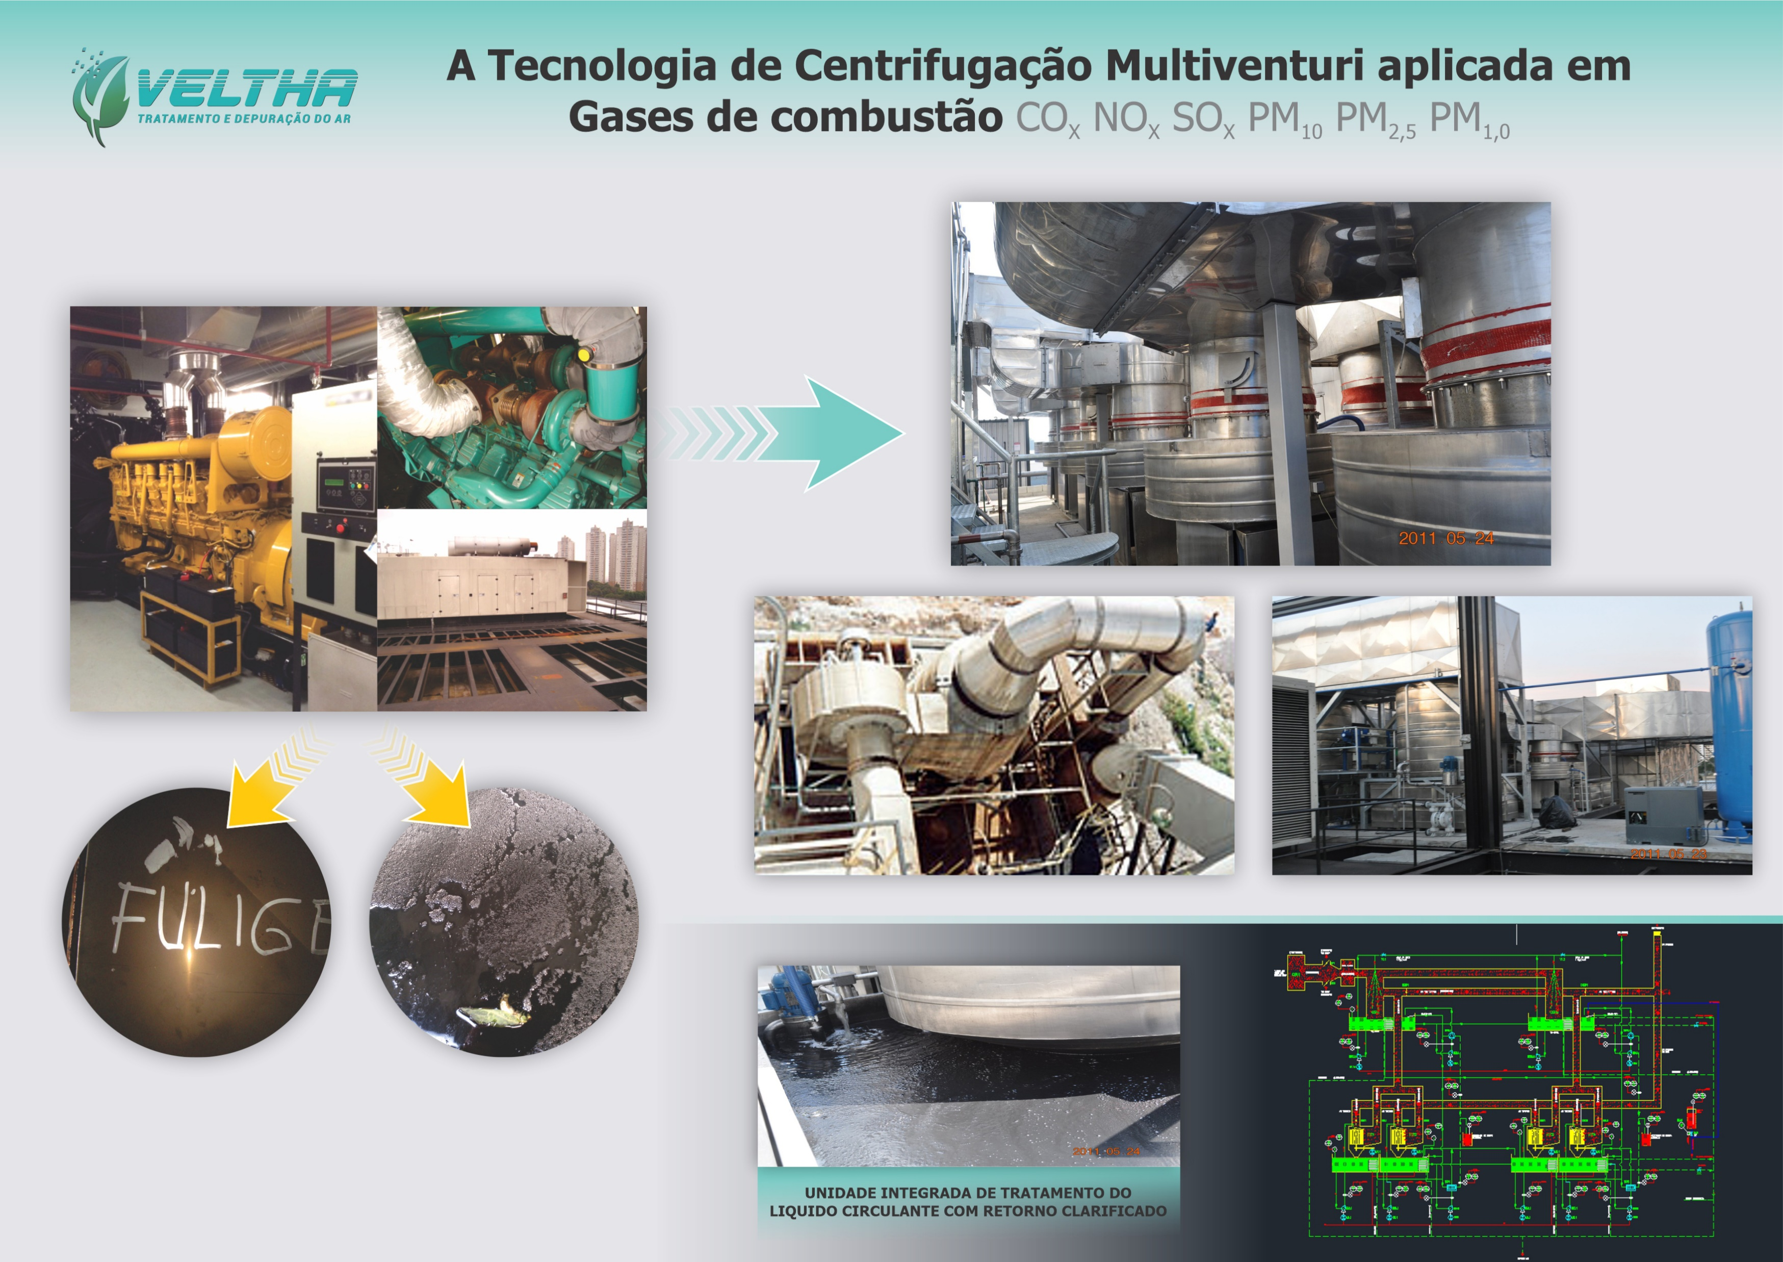
God's Divine Tip
Nature shows us the way, such as rainfall events that are capable of purifying the air in large urban centers with the precipitation of suspended particles, mainly PM₁₀, PM_{2.5}, and anthropogenic PM_{1.0}; We now have coral carbonation showing how to mitigate carbon dioxide from the atmosphere, unfortunately at the expense of marine life, but which has become a natural marker of environmental degradation.
Chemical Route
"

Slide 10
CCT- TECHNOLOGY TO MULTIVENTURI REFRIGERATED LIQUID CENTRIFUGATION.
Hydrodynamic Precipitators differ completely from the traditional countercurrent absorption towers currently adopted, as they promote a high contact factor, behaving as a compact and very effective dynamic reactor in converting two-phase reactions such as capture, solubilization, and conversion of carbon dioxide, into a marketable product.
Characterized by a “limit load” type rotor capable of promoting the SELF-ASPIRATING of the gaseous stream and its centrifugation with cooled alkaline liquid, to inoculate the carbon dioxide in the liquid medium that is a reaction and converts the gas into a soluble salt solid in one step single; This direct concept is the CCT, which transforms CO2 into a commercial product directly, without gaseous storage for future use or simply keeping it stored for no purpose and with maintenance and management costs for monitoring these underground gaseous wells.
Figures, Images, Charts or Tables
Hydrodynamic precipitator technology with multiventuri centrifuge rotor, a dynamic reactor with a high conversion rate. (Source: Veltha despoluição atmosférica www.veltha.com.br)

Slide 11
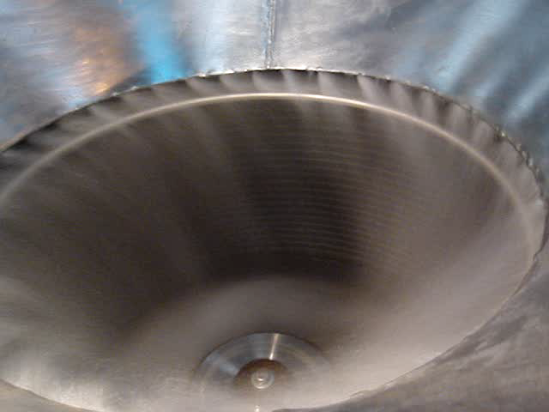
DYNAMIC REACTOR BY HYDRODINAMIC PRECIPITATOR

Slide 12
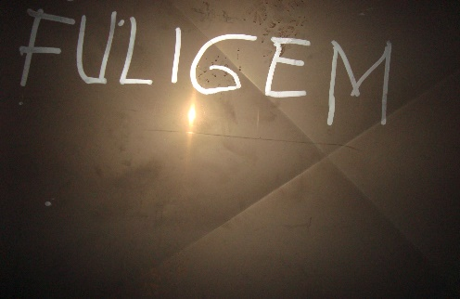
Effective empirical CCT trial
Based on a neighborhood impact demand for combustion gases, we had the opportunity to develop an application study in a plant of five generating sets that total 12.5 MW of energy generated from diesel oil.
Multiventuri liquid centrifugation technology has been developed and applied with the scope of controlling pollutants such as particulate matter, acid neutralization, vapor condensation, and odor control, and in this application study, we come across the prospect of carbon fixation as a way to score the project positively in a LEED classification analysis and generation of carbon credits.
Thus, from the conception and implementation of the multiveturi alkaline liquid centrifugation technology of hydrodynamic precipitators applied to the treatment of combustion gases in a 12.5 MW plant of 5 X 2500 kVA generator sets, with Cummins engines model DQKC, 16-cylinder turbo diesel oil. They are state-of-the-art micro-processed TIE3 engines, and in practice, they emit pollutants with a smaller amount of particulate matter, but are more harmful, as PM_{2.5} and PM_{1.0} prevail, and with higher rates of CO₂, as the combustion is perfect.
FLOW 100.000 m³/h
SOOT
2500 kVA TIE3 microprocessor turbocharger engine and fine particulate emissions.
(Source: Cummins data sheet- SP)

Slide 13
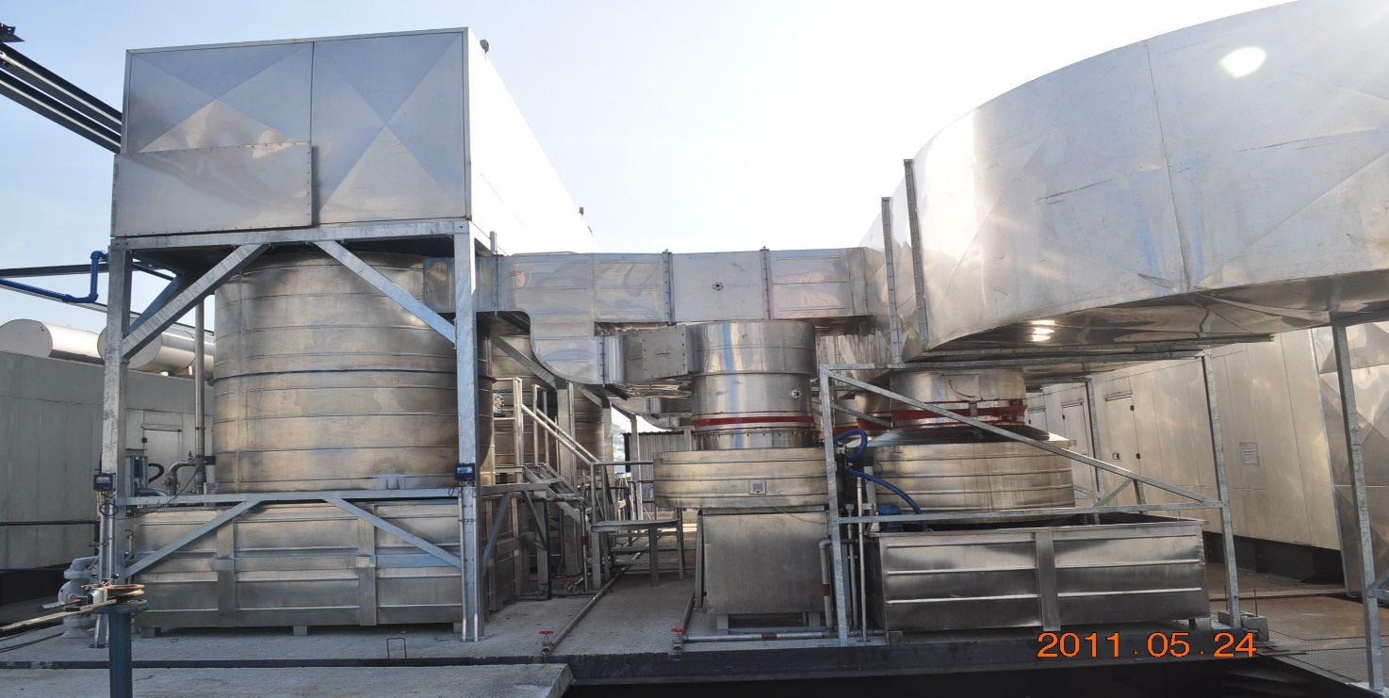
CCT- Hardware to Effective Solution
The combustion gas treatment system operates as a complete integrated solution, and the reports demonstrate the feasibility of decarbonizing gases by alkaline neutralization of carbonic acid in a stable, water-soluble salt, which has economic value and favorable stoichiometry as it incorporates mass from a component that is in the air(CO2).
The installation consists of an expansion plenum that receives the discharge of hot gases (450°C) from the five generators at a speed of 30 m/s with the gas stream being admitted to the primary quencher. When the gases have their temperature reduced to 120°C and the moisture content raised to a saturated level. These pre-treated combustion gases are admitted, due to the depression generated by the hydrodynamic precipitators, into the centrifuge rotor when they are subjected to synergistic mixing with the injected cooled alkaline liquid, forming a reaction mixture in which carbonic acid, CO2, is converted into sodium bicarbonate.
PLENUM
QUENCHER
Figures, Images, Charts or Tables
The treated gases are discharged into the atmosphere and the circulating liquid is filtered, forming a cake of particulate matter, with the clarified liquid circulating until saturation when precipitation of sodium salts occurs. System has pH control correction set up pH= 8.5 , pumps dosing a 25% sodium hydroxide solution that is consumed according to the load of oxides present in the combustion gas stream, without any waste.
HYDRODINAMIC PRECIPITATOR
12.5 MW cogeneration plant, expansion plenum, and primary combustion gas quencher on the left of the photo, and in the center the hydrodynamic precipitators in parallel arrangement (Source: Author in the field- SP)

Slide 14
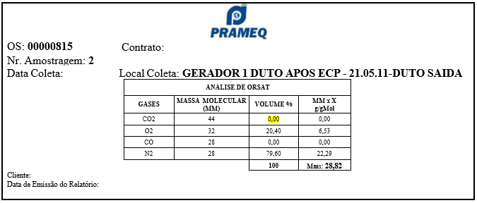
Performance certification of trial
Final emissions for the parameters of particulate matter, sulfur oxides, and carbon dioxide. The report issued with field measurements results in the total absence of CO and CO₂ in the gas stream exhausted to the atmosphere, as shown; That said, we began to investigate the presence of sodium bicarbonate in the liquid solution circulating in the system, confirmed by analysis by the Mauá Institute of Technology.
Summary of the combustion gas analysis report after the ECP (pollution control equipment). (Source: Relatório Prameq - SP)

Slide 15
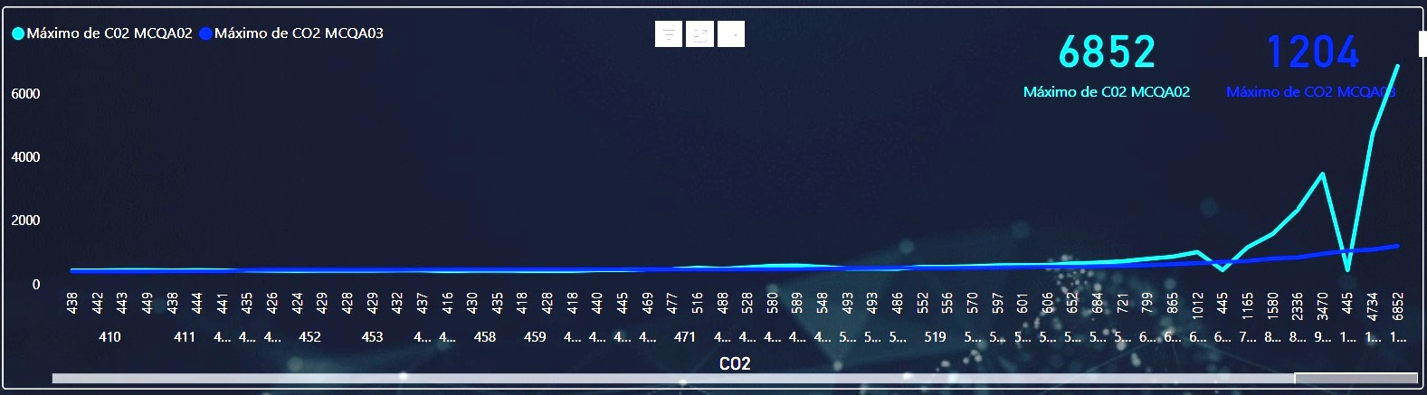
CCT New trial to Urban Air
Another test in an air intake installation in a shopping center and at an event in a large exhibition center, whose objective was saline removal, and we also continuously and remotely monitored parameters such as PM₁₀, PM_{2.5}, PM_{1.0}, CO₂ for six consecutive days and in the end we simulated an extreme carbon dioxide scenario, and the results showed an efficiency of 82.4% in reducing this gas even at a concentration of more than 6000 ppm.
Continuous monitoring of CO2, simultaneous intake and discharge of air in an urban installation. (Source: Monitor Continuo 3R Brasil- RJ)

Slide 16
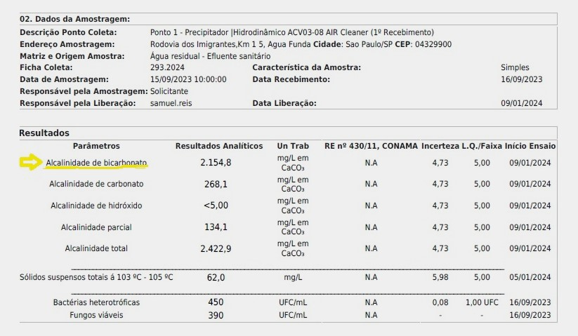
CCT New trial to Urban Air : proof of carbonaceous salt formation in situ
Continuous monitoring before and after refrigerated alkaline centrifugation demonstrates this performance and the circulating liquid report proves the transformation of CO2 into sodium bicarbonate and bacterial and fungal colonies equivalent to those of drinking water
GHS Analysis Report No.: 3946.2024-V.0 of circulating liquid. (Source: Report GHS – SP/RJ)

Slide 17
Conclusion
CCT Concept
Carbon Capture Transform is an immediate solution for addressing rising atmospheric CO2 levels.
Technology Utilization
Multiventuri centrifugation is identified as the most efficient method for capturing and transforming gaseous CO2.
Product Transformation
The captured CO2 can be converted "in situ" into solid commercial salt or into a nutrient for the cultivation of cyanophyte algae.
Cyanophytic algae can be transformed into protein raw materials, biomass or for oil extraction.
Conversion of harmful substances into valuable products for use by society.
Refrigerated Cycle Operation
Effective for direct CO2 capture from stationary sources or improving air quality through the removal of fine particulate matter (PM2.5 and PM1.0).
Future Research Directions
Ongoing research aims to develop complete units aligned with circular economy principles.

Slide 18


Access all
Conference Papers
IBP Digital Library
biblioteca.ibp.org.br

