Slide 1


AIR CLEANER
TO MAKE UP AIR
IN ADVERSE THERMAL
AND ENVIRONMENTAL
CONDITIONS
FIRST INTERNATIONAL CONFERENCE ON ENERGY AND INDOOR ENVIRONMENT FOR HOT CLIMATES
DOMENICO CAPULLI – MEMBER ASHRAE
NATALIA M. N. OLIVEIRA – STUDENT ASHRAE

Slide 2

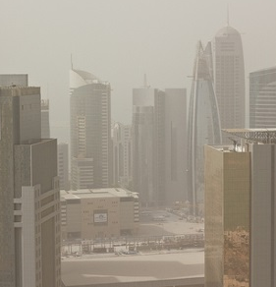
OBJECTIVE
Solution for air pollution problem of HVAC system air intake in the urban centers of hot climates areas.
Source: http://thedancinggypsy.wordpress.com/
AIR CLEANER TO MAKE UP AIR IN ADVERSE THERMAL AND ENVIRONMENTAL CONDITIONS
Domenico Capulli – Natalia M. N. Oliveira

Slide 3
HOT CLIMATES SCENE
High thermal loads from May to August
Temperature: 46°C (115°F) to 30°C (86°F)
Daily Humidity: 25% to 82%
Desert regions
Coastal Cities
Outdoor air containing marine salt, silica dust and urban pollutant.
AIR CLEANER TO MAKE UP AIR IN ADVERSE THERMAL AND ENVIRONMENTAL CONDITIONS
Domenico Capulli – Natalia M. N. Oliveira

Slide 4
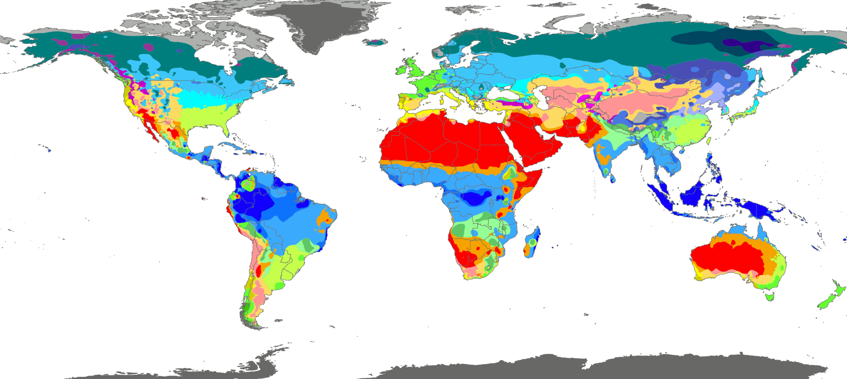
HOT CLIMATES SCENARIO
Source: Peel, M. C. and Finlayson, B. L. and McMahon, T. A. (2007)
AIR CLEANER TO MAKE UP AIR IN ADVERSE THERMAL AND ENVIRONMENTAL CONDITIONS
Domenico Capulli – Natalia M. N. Oliveira

Slide 5
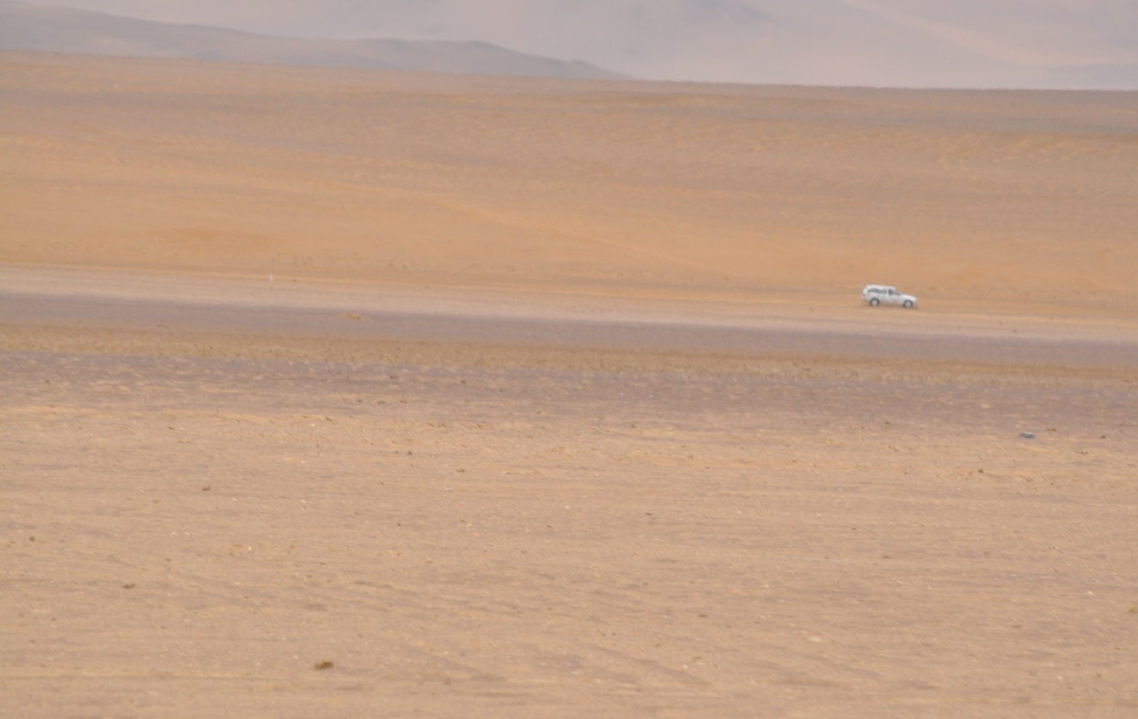
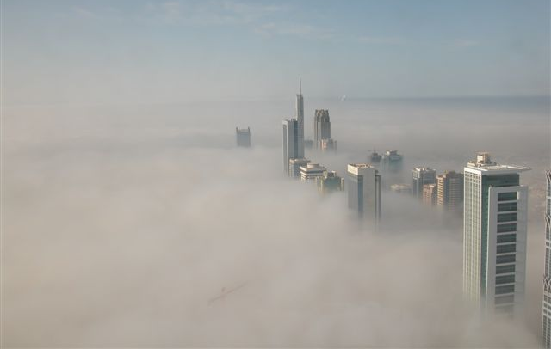
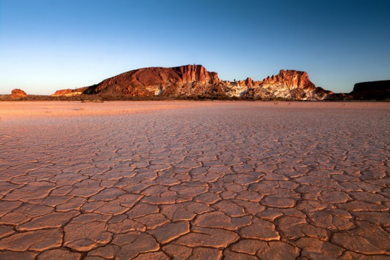
HOT CLIMATES SCENARIO
AIR CLEANER TO MAKE UP AIR IN ADVERSE THERMAL AND ENVIRONMENTAL CONDITIONS
Domenico Capulli – Natalia M. N. Oliveira

Slide 6
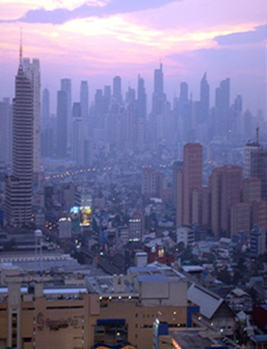
URBAN CENTERS
High concentration of people
High concentration of vehicles
High concentration of pollutants
AIR CLEANER TO MAKE UP AIR IN ADVERSE THERMAL AND ENVIRONMENTAL CONDITIONS
Domenico Capulli – Natalia M. N. Oliveira

Slide 7
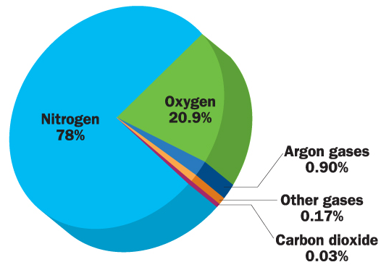
DRY AIR COMPOSITION
NAME | FORMULE | PROPORTION
Nitrogen | N₂ | 78,08 %
Oxygen | O₂ | 20,95 %
Argon | Ar | 0,934 %
Carbon Dioxide | CO₂ | 0,03% (382 ppm)
Neon | Ne | 18,18 ppm
Helium | He | 5,24 ppm
Nitrogen Monoxide | NO | 5 ppm
Krypton | Kr | 1,14 ppm
Methane | CH₄ | 1,7 ppm
Hydrogen | H₂ | 0,5 ppm
Nitrogen Protoxide | N₂O | 0,5 ppm
Xenon | Xe | 0,087 ppm
Nitrogen Dioxide | NO₂ | 0,02 ppm
Ozone | O₃ | 0 à 0,01 ppm
Radon | Rn | 6,0×10⁻¹⁴ ppm
Source: http://thedancinggypsy.wordpress.com/
AIR CLEANER TO MAKE UP AIR IN ADVERSE THERMAL AND ENVIRONMENTAL CONDITIONS
Domenico Capulli – Natalia M. N. Oliveira

Slide 8
POLLUTANTS
Particle Matter (PM)
Ozone (O₃)
Sulphur Dioxide (SO₂)
Carbon Monoxide (CO)
Carbon Dioxide (CO₂)
Nitrogen Dioxide (NO₂)
AIR CLEANER TO MAKE UP AIR IN ADVERSE THERMAL AND ENVIRONMENTAL CONDITIONS
Domenico Capulli – Natalia M. N. Oliveira

Slide 9
PARTICLE MATTER
Marine salt for coastal cities
Silica dust in desert regions
Air Quality Patterns to Indoor Environments
Source: ASHRAE Standard 62.1-2013
SUBSTANCE | NAAQS/EPA | OSHA | MAK | ACGIH | ANVISA
Particles < 2.5 µm MMAD | 15 µg/m³ 35 µg/m³ | 5 mg/m³ - | 1.5 mg/m³ for 4 ppm - | 3 mg/m³ - | 80 µg/m³
Particles < 10 µm MMAD | 150 µg/m³ | - | 4 mg/m³ | 10 mg/m³
AIR CLEANER TO MAKE UP AIR IN ADVERSE THERMAL AND ENVIRONMENTAL CONDITIONS
Domenico Capulli – Natalia M. N. Oliveira

Slide 10
PARTICLE MATTER
Source: The Physics of wind-blown sand and dust, 2012
AIR CLEANER TO MAKE UP AIR IN ADVERSE THERMAL AND ENVIRONMENTAL CONDITIONS
Domenico Capulli – Natalia M. N. Oliveira

Slide 11
PARTICLE MATTER
Damages of high concentration of particles in suspension:
Health: Serious lung problems;
Property: Malfunction of electrical equipments,
Corrosion of electrical components.
The wide range of variation in the concentration of dissolved salts severely affects corrosion rates.
(Arabian Sea: 39,000 to 47,000 ppm)
AIR CLEANER TO MAKE UP AIR IN ADVERSE THERMAL AND ENVIRONMENTAL CONDITIONS
Domenico Capulli – Natalia M. N. Oliveira

Slide 12
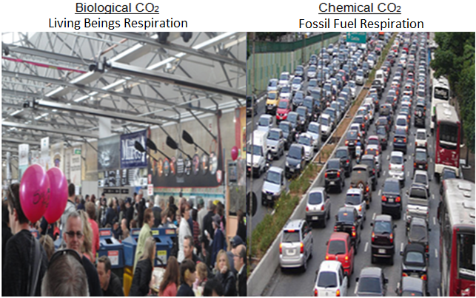
CARBON DIOXIDE
CARBONIC ISLANDS
AIR CLEANER TO MAKE UP AIR IN ADVERSE THERMAL AND ENVIRONMENTAL CONDITIONS
Domenico Capulli – Natalia M. N. Oliveira

Slide 13
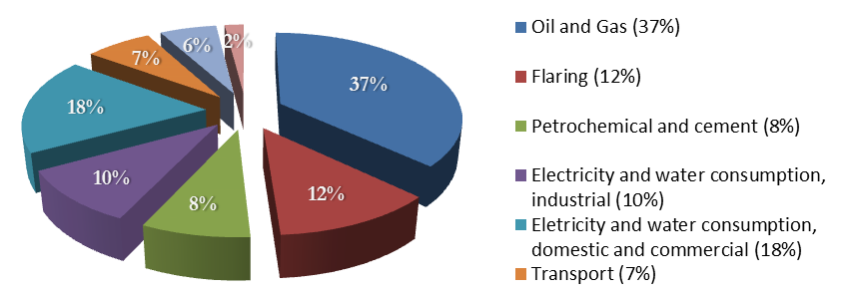
CARBON DIOXIDE
Carbon Dioxide Emission
Source: Qatar General Secretariat for Development Planning, 2011. Qatar National Development
Strategy 2011~2016
AIR CLEANER TO MAKE UP AIR IN ADVERSE THERMAL AND ENVIRONMENTAL CONDITIONS
Domenico Capulli – Natalia M. N. Oliveira

Slide 14
CARBON DIOXIDE
Air Quality Patterns to Indoor Environments
Source: ASHRAE Standard 62.1-2013
SUBSTANCE | NAAQS/EPA | OSHA | MAK | ACGIH | ANVISA
Carbon Dioxide | - - | 5000 ppm - | 5000 ppm 10,000 ppm [1h] | 5000 ppm 30,000 ppm [15 min] | 1000 ppm -
AIR CLEANER TO MAKE UP AIR IN ADVERSE THERMAL AND ENVIRONMENTAL CONDITIONS
Domenico Capulli – Natalia M. N. Oliveira

Slide 15
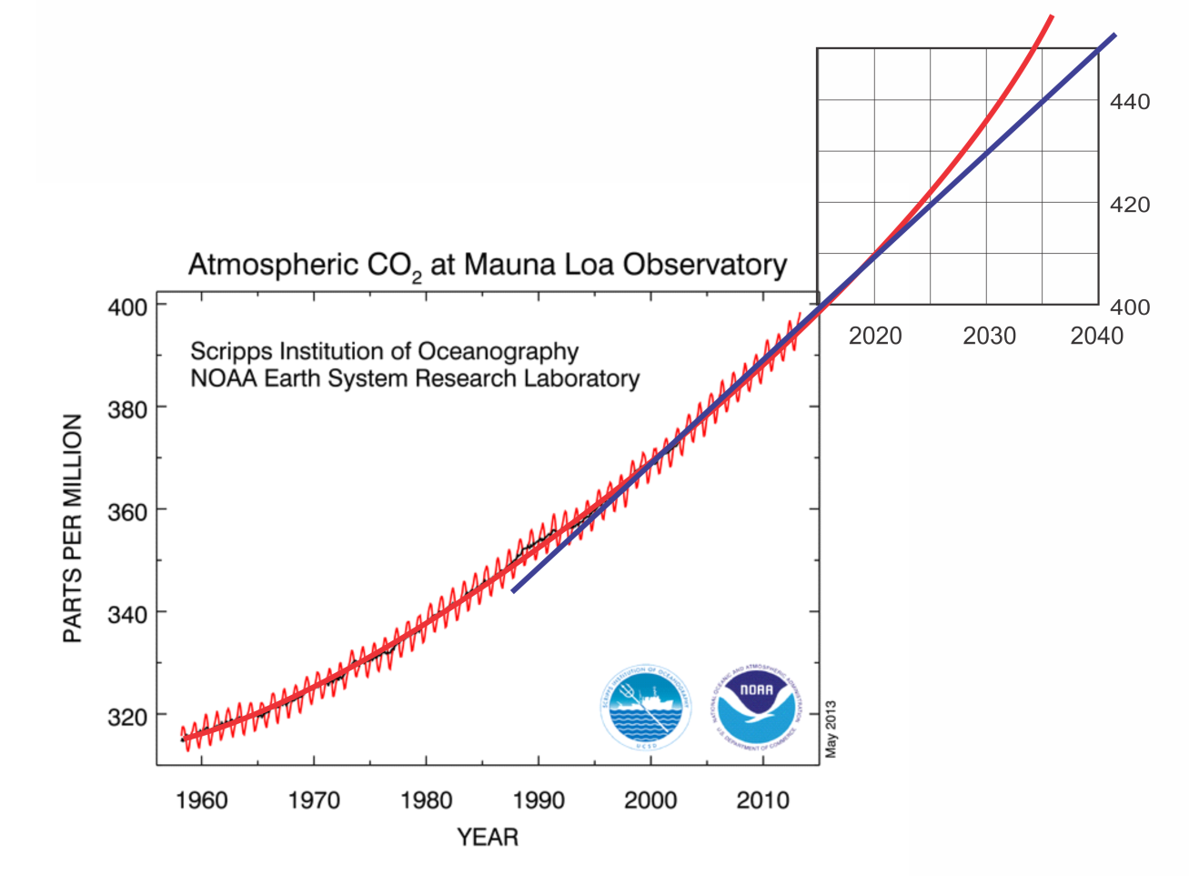
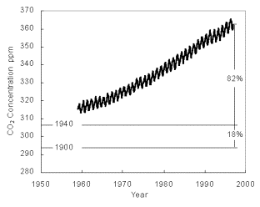
CARBON DIOXIDE
Evolution of the Average Global Concentration of Carbon Dioxide (Greenhouse Gas)
AIR CLEANER TO MAKE UP AIR IN ADVERSE THERMAL AND ENVIRONMENTAL CONDITIONS
Domenico Capulli – Natalia M. N. Oliveira

Slide 16
CARBON DIOXIDE
Damages of concentration higher than the allowable limit:
SBS: Sick Building Syndrome
Health Effects
Source: ASHRAE Standard 62.1-2013
CONCENTRATION (ppm) | EFFECTS
7000 | Demineralization of bones
> 20,000 | Deep Breathing
40,000 | Increase of respiration rate
100,000 | Visual disorders , tremor and loss of consciousness
250,000 | It may result in death
AIR CLEANER TO MAKE UP AIR IN ADVERSE THERMAL AND ENVIRONMENTAL CONDITIONS
Domenico Capulli – Natalia M. N. Oliveira

Slide 17
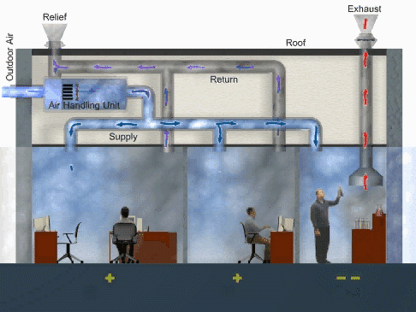

THE PROBLEM
Source: Environmental Protection Agency (EPA)
AIR CLEANER TO MAKE UP AIR IN ADVERSE THERMAL AND ENVIRONMENTAL CONDITIONS
Domenico Capulli – Natalia M. N. Oliveira

Slide 18
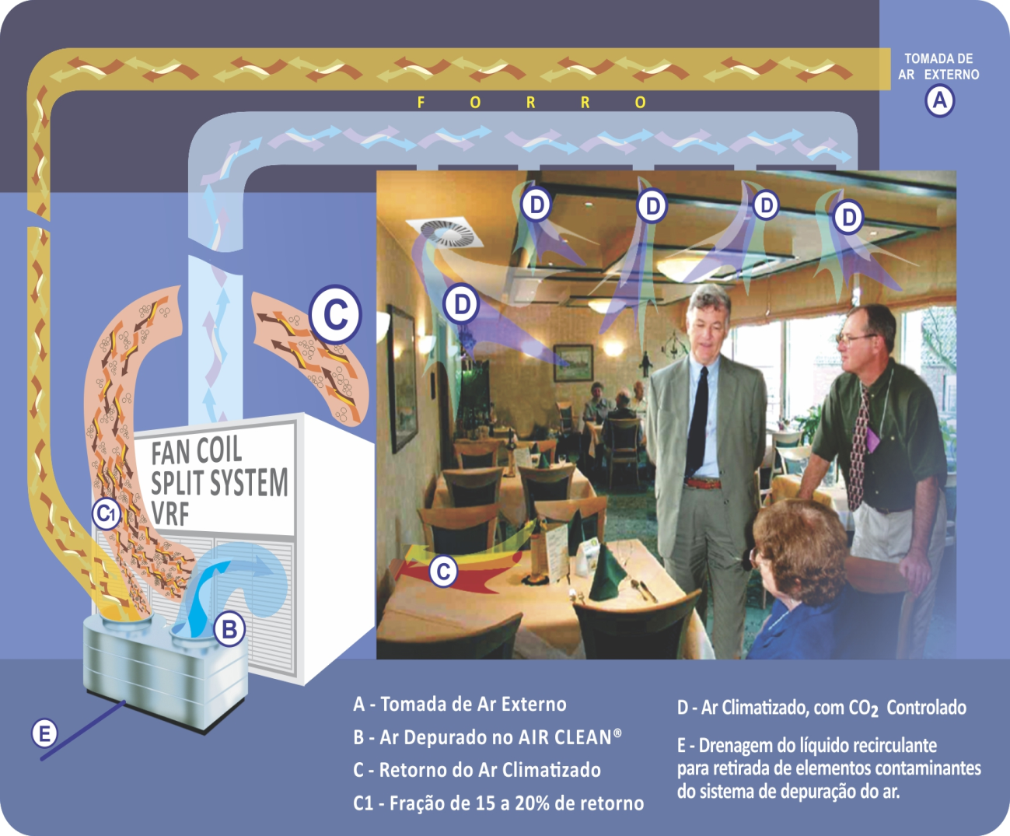
THE SOLUTION
AIR CLEANER TO MAKE UP AIR IN ADVERSE THERMAL AND ENVIRONMENTAL CONDITIONS
Domenico Capulli – Natalia M. N. Oliveira

Slide 19
MULTIVENTURI TECHNOLOGY
Hydrodynamic Precipitator
Fluid Mechanics Principles
Mass and energy transfer
Absorption and condensation phenomena
Centrifugal acceleration through multiventuri liquid spinning centrifuge
Dynamic chemical reactor of carbonation
AIR CLEANER TO MAKE UP AIR IN ADVERSE THERMAL AND ENVIRONMENTAL CONDITIONS
Domenico Capulli – Natalia M. N. Oliveira

Slide 20
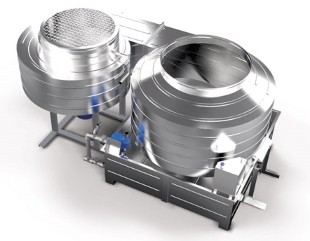
MULTIVENTURI TECHNOLOGY
Hydrodynamic Precipitator
AIR CLEANER TO MAKE UP AIR IN ADVERSE THERMAL AND ENVIRONMENTAL CONDITIONS
Domenico Capulli – Natalia M. N. Oliveira

Slide 21
MULTIVENTURI TECHNOLOGY
Advantages:
Effective and high performance tools
Energy efficiency using LEED score
Removal of solid material suspended
Treated air at lower temperature than outdoor air
AIR CLEANER TO MAKE UP AIR IN ADVERSE THERMAL AND ENVIRONMENTAL CONDITIONS
Domenico Capulli – Natalia M. N. Oliveira

Slide 22
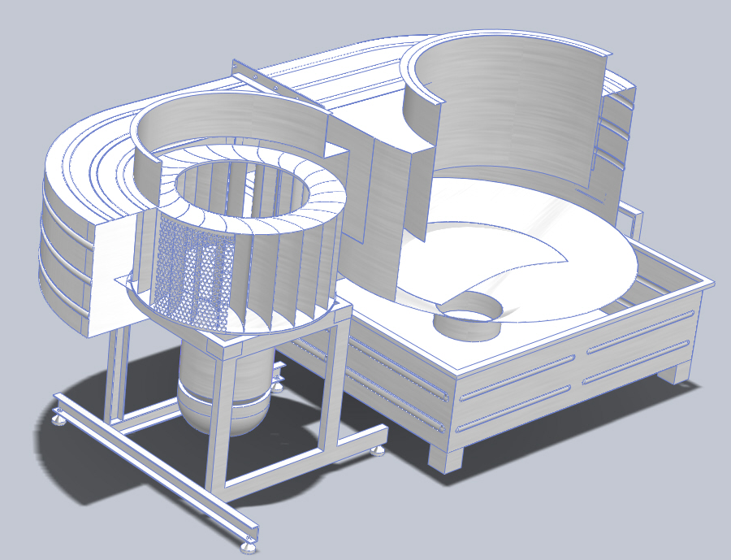
MULTIVENTURI TECHNOLOGY
AIR CLEANER TO MAKE UP AIR IN ADVERSE THERMAL AND ENVIRONMENTAL CONDITIONS
Domenico Capulli – Natalia M. N. Oliveira

Slide 23
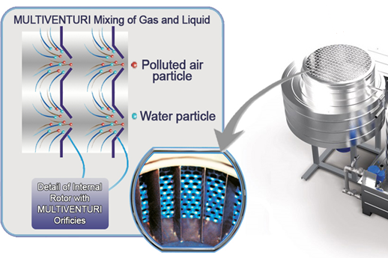
MULTIVENTURI TECHNOLOGY
AIR CLEANER TO MAKE UP AIR IN ADVERSE THERMAL AND ENVIRONMENTAL CONDITIONS
Domenico Capulli – Natalia M. N. Oliveira

Slide 24
MULTIVENTURI TECHNOLOGY
Applications:
Pulp and paper plants with chloride ions
Combustion gases and/or sulfurous and nitric atmospheres with petrochemical and chemical plants
Particulate matter in mining, siderurgy, coal coke yard, hydrogen sulfide in units of effluent treatment or close of swamps and mangroves
Salty sea air containing sodium chloride in all coastal areas (radius = 8 km)
AIR CLEANER TO MAKE UP AIR IN ADVERSE THERMAL AND ENVIRONMENTAL CONDITIONS
Domenico Capulli – Natalia M. N. Oliveira

Slide 25
CASE OF APLICATION
Petrobrás BR Case: Base control building of air taken of natural gas re-gasification – LNG
Removal of salt ions and coke after processing
Cooling to the wet bulb (25,8°C = 78,4°F)
Treated air distributed to three engine rooms:
ENGINE ROOM | FLOW (m³/h) | THERMAL LOAD (TR) | COMPONENTS
VAC 1 | 2870 | 20 | Shelters the electrical panels, transformers, battery room
VAC 2 | 650 | 20 | Control room and TI/TCOM compartments
VAC 3 | 1360 | 7,5 | Operational support offices and locker rooms
AIR CLEANER TO MAKE UP AIR IN ADVERSE THERMAL AND ENVIRONMENTAL CONDITIONS
Domenico Capulli – Natalia M. N. Oliveira

Slide 26
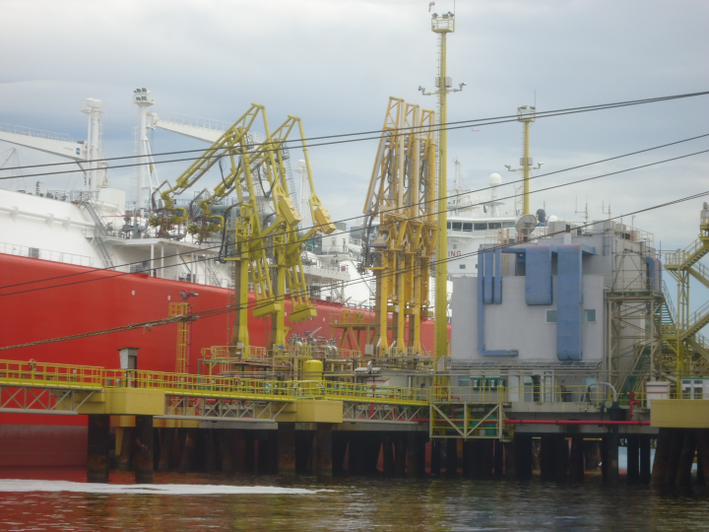
CASE OF APLICATION
AIR CLEANER TO MAKE UP AIR IN ADVERSE THERMAL AND ENVIRONMENTAL CONDITIONS
Domenico Capulli – Natalia M. N. Oliveira

Slide 27
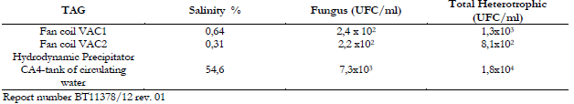
CASE OF APLICATION
Analysis of Fan Coils over the last 2 years of continuous operation:
Preserved copper pipe
Results of analysis of liquid collected from Fan Coils
AIR CLEANER TO MAKE UP AIR IN ADVERSE THERMAL AND ENVIRONMENTAL CONDITIONS
Domenico Capulli – Natalia M. N. Oliveira

Slide 28
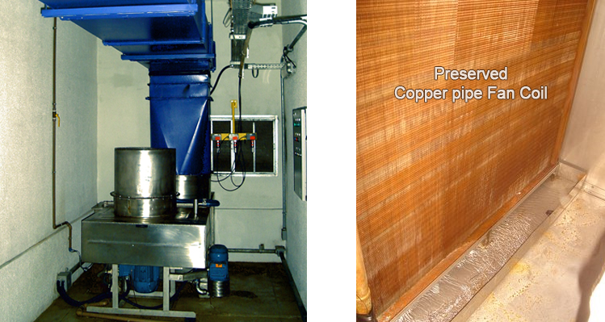
CASE OF APLICATION
AIR CLEANER TO MAKE UP AIR IN ADVERSE THERMAL AND ENVIRONMENTAL CONDITIONS
Domenico Capulli – Natalia M. N. Oliveira

Slide 29

CONCLUSION
Liquid centrifugation
GROUNDBREAKING TECHONOLOGY
LEED
Control of particulates, mists and gases
AIR CLEANER TO MAKE UP AIR IN ADVERSE THERMAL AND ENVIRONMENTAL CONDITIONS
Domenico Capulli – Natalia M. N. Oliveira

Slide 30
ACKNOWLEDGMENTS
In memory of scientist Giuseppe Capulli for his legacy of perseverance, tenacity and creativity whose struggle in technological innovation and wellbeing of our environment helped the continuous improvement of the life quality of mankind.
AIR CLEANER TO MAKE UP AIR IN ADVERSE THERMAL AND ENVIRONMENTAL CONDITIONS
Domenico Capulli – Natalia M. N. Oliveira

Slide 31
THANK YOU
AIR CLEANER TO MAKE UP AIR IN ADVERSE THERMAL AND ENVIRONMENTAL CONDITIONS
Domenico Capulli – Natalia M. N. Oliveira

Slide 32
QUESTIONS?
E-mail: nataliamno@yahoo.com.br
Tel.: +55 21 99642-0132
AIR CLEANER TO MAKE UP AIR IN ADVERSE THERMAL AND ENVIRONMENTAL CONDITIONS
Domenico Capulli – Natalia M. N. Oliveira

